Slide 1
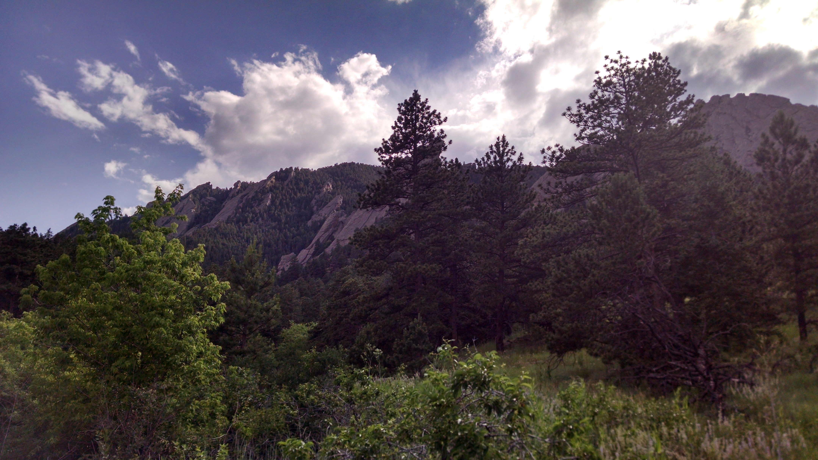
ECOSYSTEM ECOLOGY

Slide 2
What is ecology?

Slide 3
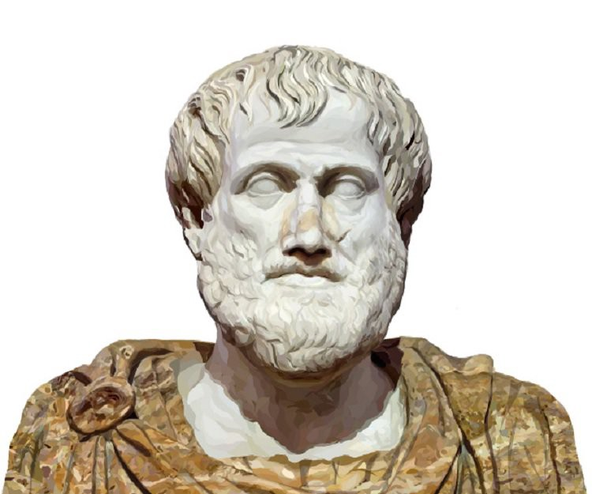
Ecology
From the Greek “oikos” for house . . . Literally . . . The study of one’s house
Ancient Greek philosophers such as Hippocrates and Aristotle were among the first to record observations on natural history, but viewed life in terms of essentialism, where species were conceptualized as static unchanging things while varieties were seen as aberrations of an idealized type.

Slide 4
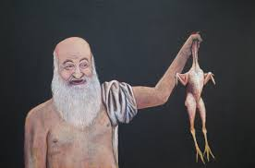
Plato’s “man”
According to Diogenes Laërtius’ third-century Lives and Opinions of the Eminent Philosophers, Plato was applauded for his definition of man as a featherless biped, so Diogenes the Cynic “plucked the feathers from a cock, brought it to Plato’s school, and said, ‘Here is Plato’s man.’”

Slide 5
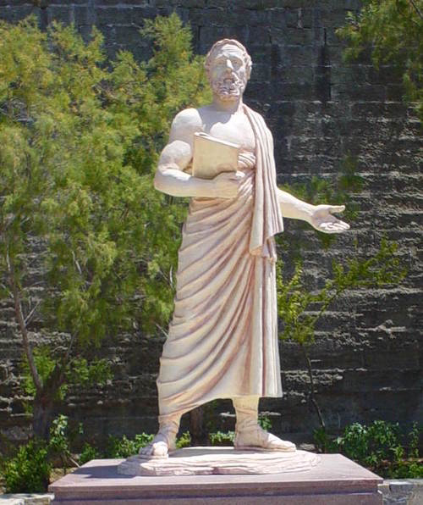
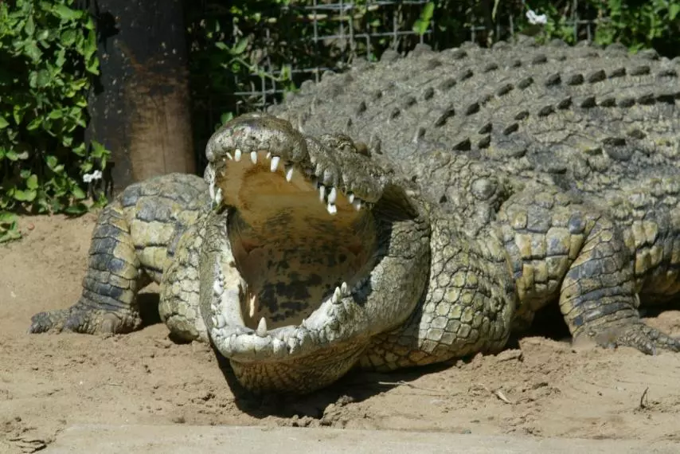
Herodotus, the crocs, and the birds

Slide 6
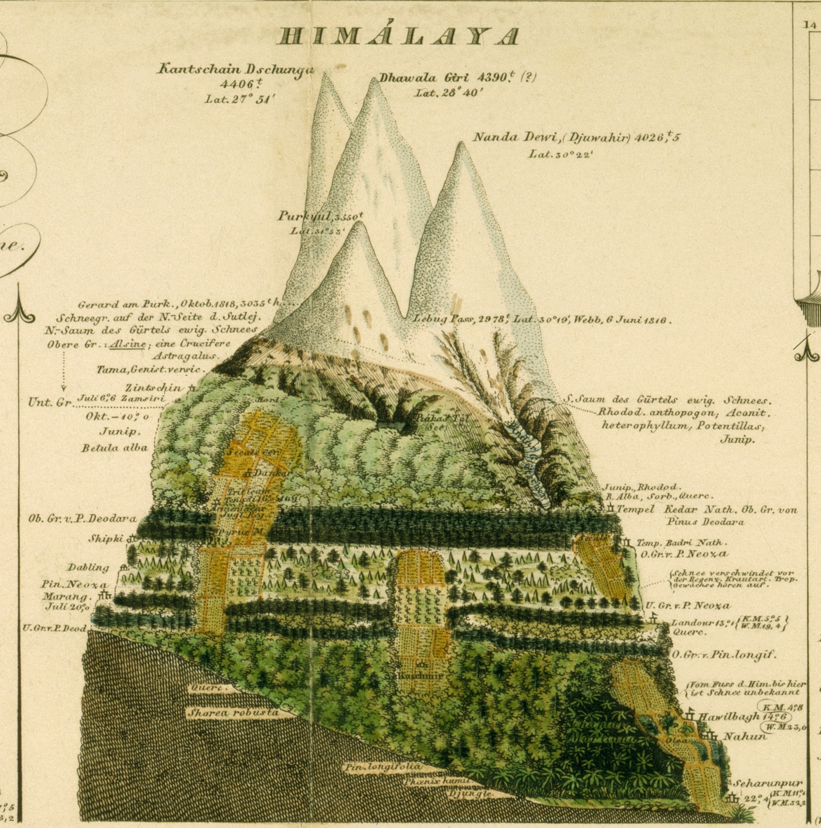
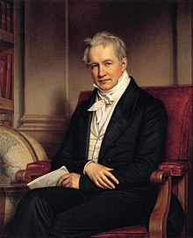
Alexander von Humboldt
Origins of biogeography? Maybe? Pretty pictures though.

Slide 7
Natural history Geology
Food webs/chains
Gradients
Natural Selection
Productivity Relationships
And on and on…
Ecology!

Slide 8
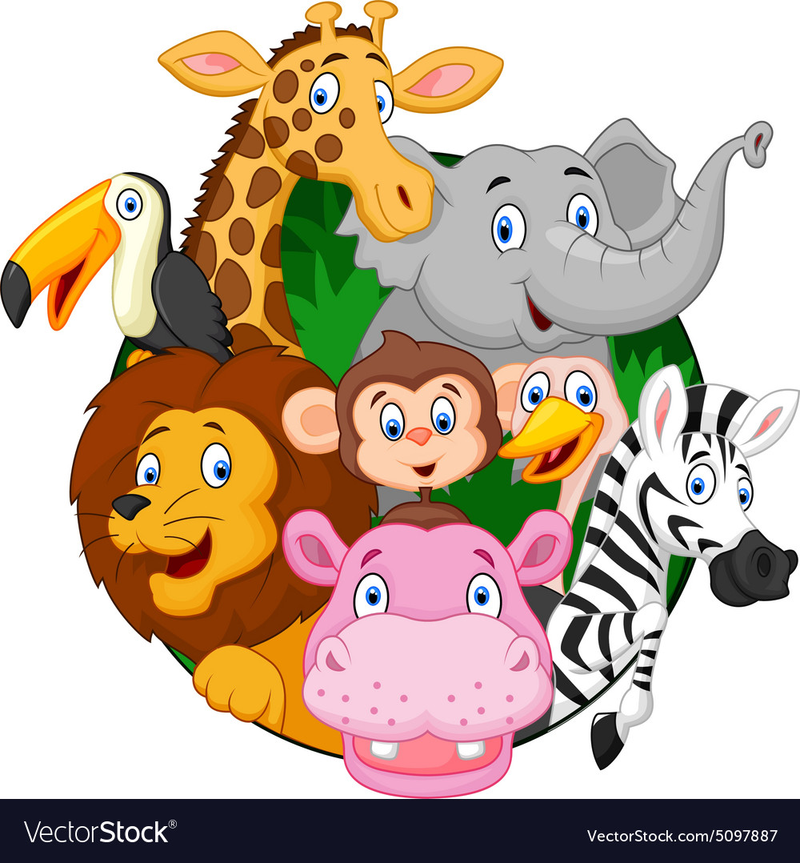
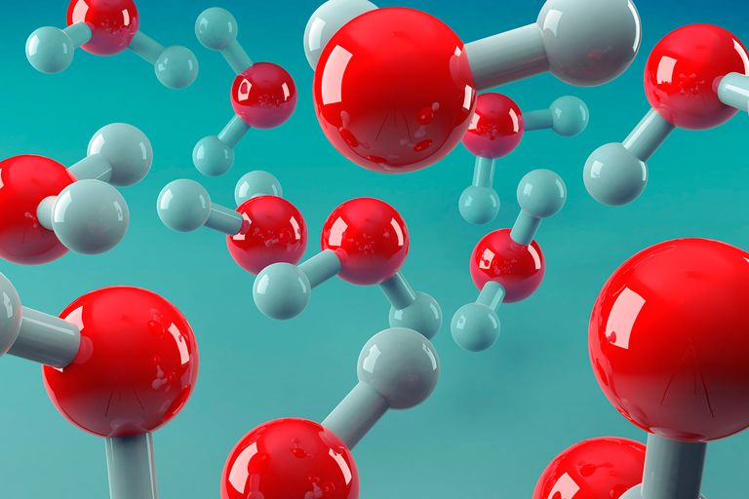
What is your unit of measure?
Individuals
Molecules

Slide 9
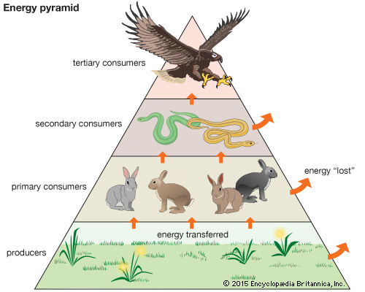
Energy flow
Common unit of currency
The whole ecosystem and all component parts
We can do so much with it!
PRODUCTIVITY! (let’s talk about it)

Slide 10
What is an ecosystem?

Slide 11
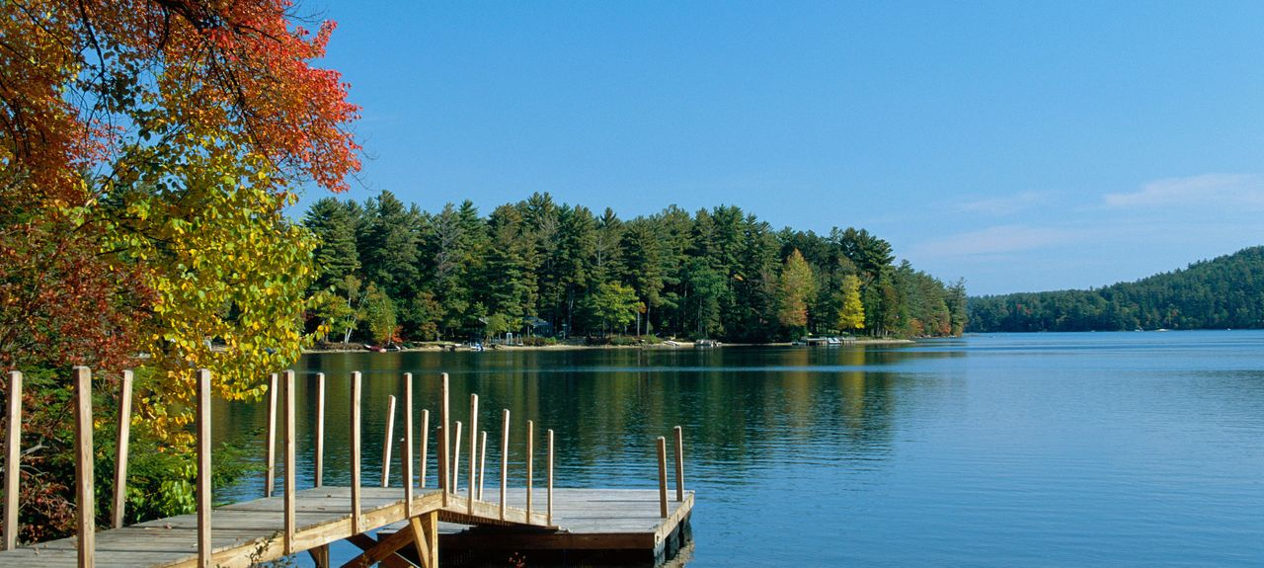
Ecosystem ecology started in lakes . . . How come?

Slide 12
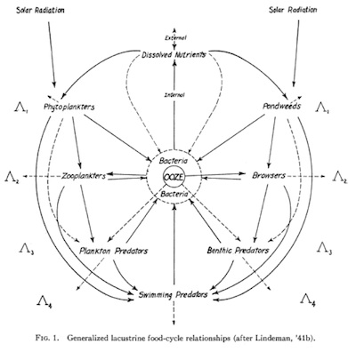
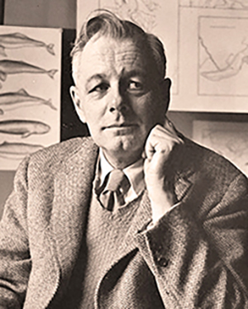
Lake as microcosm
Clear boundaries!
We can visually see it
G. Evelyn Hutchinson

Slide 13
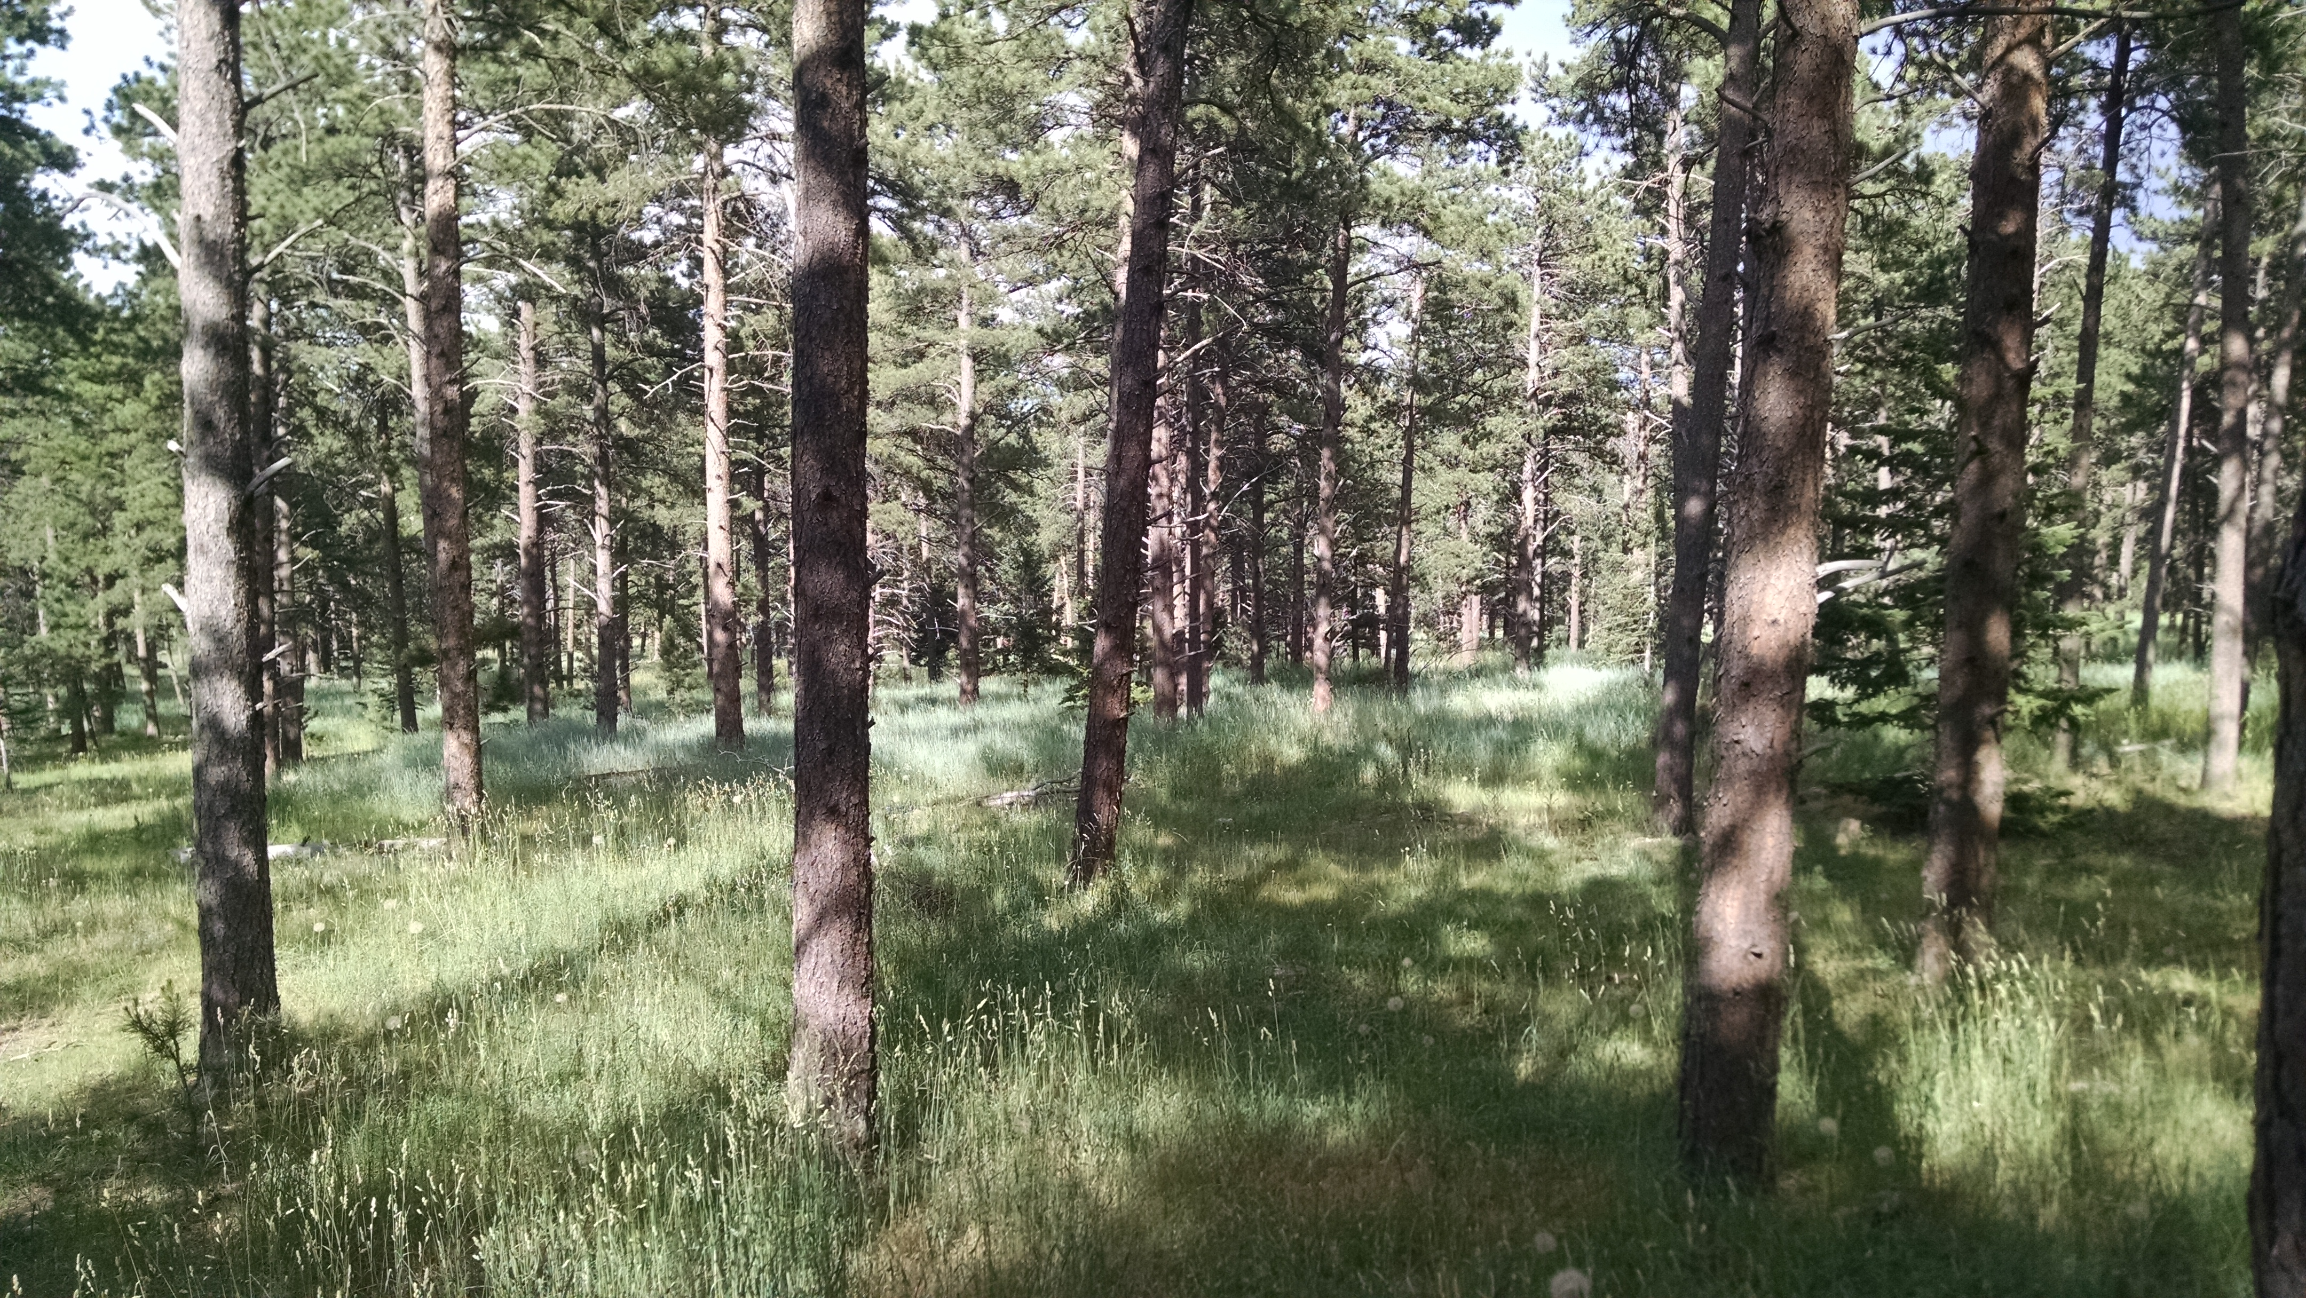

Slide 14
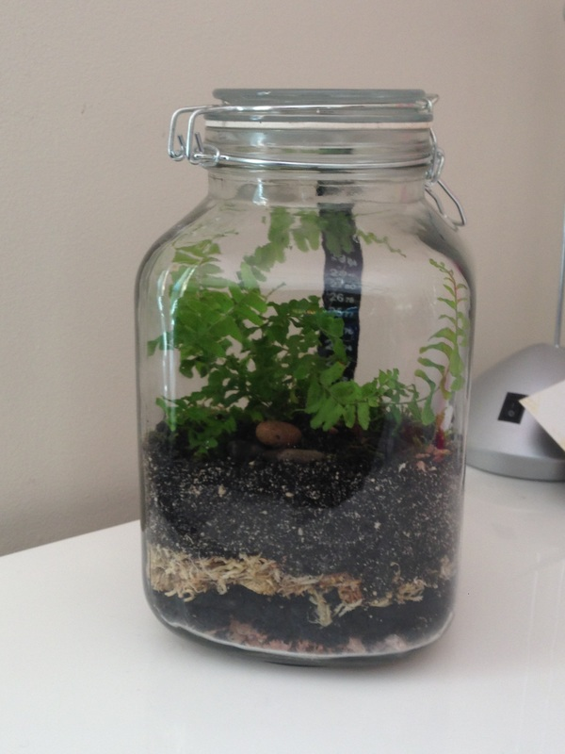
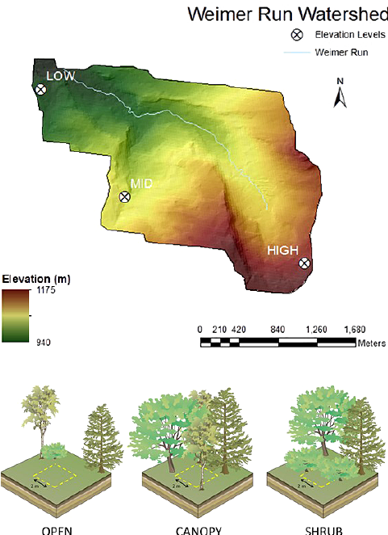
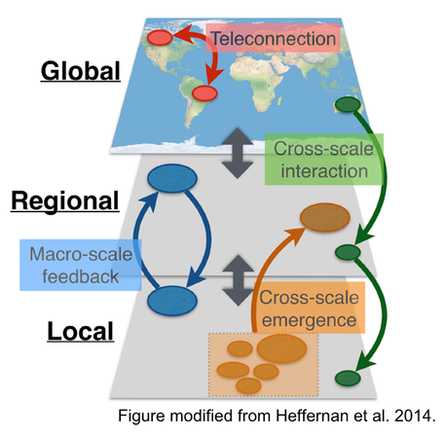
Scale?
Atkins et al. 2015
Mesocosm
Watershed
Macrosystem

Slide 15
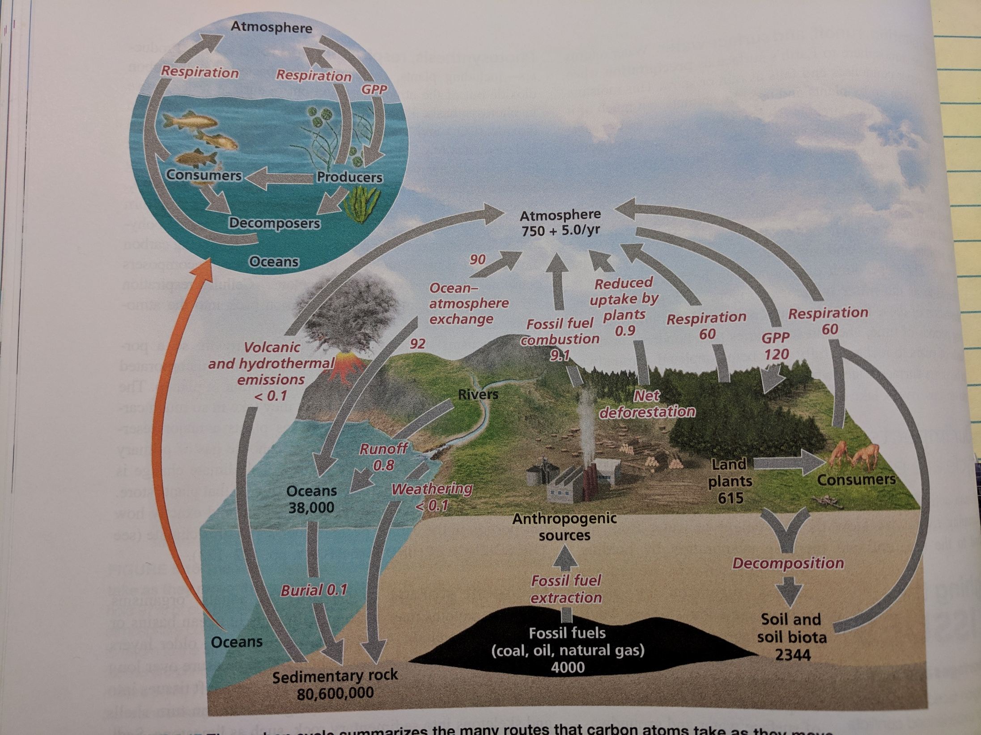

Slide 16
